Slide 1
ELEMENTARY STATISTICS, BLUMAN
Chebyshev’s Theorem
© 2019 McGraw-Hill Education. All rights reserved. Authorized only for instructor use in the classroom. No reproduction or further distribution permitted without the prior written consent of McGraw-Hill Education.

Slide 2
Objectives for this PowerPoint
Learn to use Chebyshev’s Theorem

Slide 3
Description of Table
The table on the next slide is taken from the list of the top 2843 100 meter sprint times ever recorded in sanctioned competition.

Slide 4
Data
100m Sprint Rank | Time(seconds)
1 | 9.58
2 | 9.63
3 | 9.69
3 | 9.69
3 | 9.69
6 | 9.71
7 | 9.72
7 | 9.72
9 | 9.74
9 | 9.74
. . . | . . .
100m Sprint Rank | Time (seconds)
2536 | 10.09
2536 | 10.09
2536 | 10.09
2536 | 10.09
μ = 10.017 seconds
σ = 0.070

Slide 5
Proportion of Data Points
It is frequently very useful to be able to predict where proportions of data points will lie relative to the mean of the data set.
One of the tools that is used to make these types of predictions is called Chebyshev’s Theorem.

Slide 6
Chebyshev’s Theorem
Chebyshev’s Theorem tells us that the proportion of data values that will fall within k standard deviations of the mean will be at least 1 – 1/k² where is a number greater than 1.
According to Chebyshev’s Theorem, at least what proportion of the data values lie within 2 standard deviations of the mean?
1 - 1/k² = 1 – 1/2² =1 – ¼ = ¾
This tells us that at least ¾ of the data will lie within 2 standard deviations of the mean of 10.017 seconds.
Let’s construct an interval where anything between the left endpoint and the right endpoint will be within 2 standard deviations of the mean.

Slide 7
Interval Calculation
So we will subtract times the standard deviation from 10.017 and we will add 2 times the standard deviation to 10.017.
μ - 2σ = 10.017 – 2(0.070) = 9.877
Μ + 2σ = 10.017 +2(0.070) = 10.157
This gives us endpoints of 9.877 and 10.157 seconds.

Slide 8
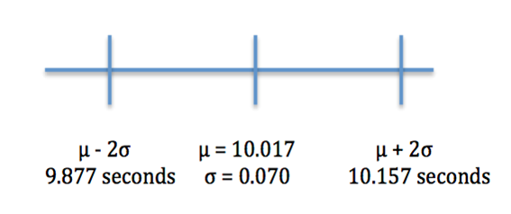
Graphical Explanation

Slide 9
Explanation
According to Chebyshev’s Theorem at least ¾ or 75% of the entire data set will be within this interval.
Looking at the entire data set, we see that none of the data values are greater than 10.157 seconds. However, we also see that 150 of the 2843 total data values are less than 9.877 seconds.
This means that 2693 out of 2843 lie within 2 standard deviations of mean. This gives us an actual proportion of .9472 or 94.72% that are inside of the interval.
Chebyshev’s Theorem stated that at least 75% of the data points would fall in this interval. This is certainly true for this data set.

Slide 10
Example
Let’s answer the question, according to Chebyshev’s Theorem, at least what proportion of the data values lie within 1.2 standard deviations of the mean?
1 – 1/k² = 1 – 1/1.2² = 1 – 1/1.44 ~ .306
μ – 1.2σ μ + 1.2σ
9.933 seconds 10.101 seconds
According to Chebyshev’s Theorem, at least 30.6 of the 100m sprint record times will fall within the interval 9.933 to 10.101 seconds.

Slide 11
Summary
In this PowerPoint we learned how to use Chebyshev’s Theorem.

